Slide 1
Ashford School Proposed Budget
2023/2024
Presented by: Cynthia Ford, Superintendent

Slide 2
Ashford Board of Education Mission
The Ashford Board of Education, in partnership with Ashford School and the community, is committed to providing a safe and positive environment that encourages lifelong learning and empowers students to succeed in their continued educational endeavors. Students will also discover their passions, strive for excellence, connect with their community and the world, and contribute in positive and meaningful ways.

Slide 3
Ashford Board of Education Goals:
CURRICULUM: Support an exceptional preschool program and ensure a kindergarten to 8th grade curriculum that engages and challenges students to use methods of inquiry to solve problems, think critically, and to express themselves creatively and effectively.
FINANCE: Develop and monitor a budget that ensures the best possible education while being fiscally responsible to taxpayers.
CULTURE: Foster an environment of physical and emotional health and wellness for all. Support a community that recognizes professional expertise and provides diverse opportunities that enhance teaching and learning.

Slide 4
Goals Continued:
COMMUNITY RELATIONS: Provide enriching opportunities for community engagement, meaningful collaboration, and partnership with all stakeholders.
FACILITIES: Serve as a leader for Ashford in enhancing energy efficiency and sustainability, developing a maintenance and restoration plan that extends the school’s useful life, and in demonstrating environmental responsibility.

Slide 5
Ongoing Improvements of 2022/2023
Implementing new math program K-8 to assist in improvement of our math standard scores on SBAC.
Piloting new reading programs in grades K-3, 4, 5, and 6.
Implementing new IEP program.
Continuing to implement our enhanced Social Emotional Learning curriculum.
Implementing a new language program for German to align with our German partnership.
Continuing to work with international organizations for exposure to world languages.

Slide 6
Ongoing Improvements of 2022/2023 continued
Consolidating Administration tasks and positions to improve efficiency and effectiveness.
Exploring cost savings in our technology while focusing on 21st century innovations.
Improving our grade level PLCs(Professional Learning Communities) to focus on data driven instruction.
Improving our Special Education programming to align with data driven goals and objectives.

Slide 7
Looking to 2023/2024
Implement a new reading program in grades K-6.
1:1 iPad introduction in grade 5 to phase out Apple laptops for cost savings.
Improve our district assessments to allow for students to demonstrate mastery of state standards.
Improve our Science programs in grades K-8.
Update our facilities to improve fossil fuel consumption.
Update our technologies throughout the building.

Slide 8
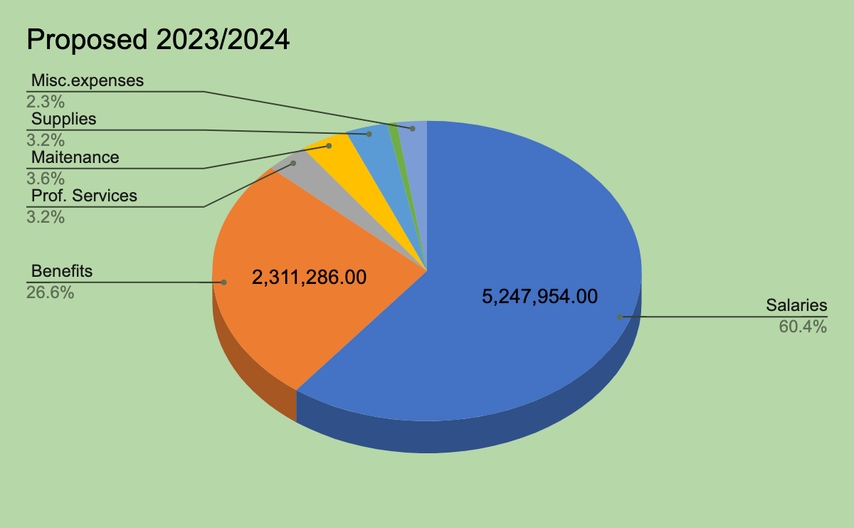
Proposed Budget for 2023/2024
Major Expenditures:
Salary increase: $53,474
Benefit increase: $224,066
Maintenance increase: $38,057
Supplies increase: $108,029
Misc. Expenses: $67,553
Insurance continues to be our largest increase.
2023-24 Proposed $8,685,288
2022-23 Budget $8,337,427
Increase $ 347,861
% increase 4.17%

Slide 9
Budget Major Reductions
Budget for only one Outplacement: Budgeted according to current status. Savings of: $135,455
Reduction in PT services from two days a week to one day a week. Savings of: $21,500
Moving from analog phone service to a cloud service for phones. Savings of: $12,250
Special Education costs have been contained through careful planning and programming to meet the individual needs of Ashfords students.
Percent of budget to Special education costs:
 | 19-20 | 20-21 | 21-22 | 22-23 | 23-24
Special Education | 1,837,459 | 1,820,090 | 1,802,602 | 1,853,663 | 1,859,153
Total Budget | 7,619,408 | 7,594,017 | 7,915,110 | 8,337,427 | 8,685,288
Percent of Special education | 24% | 24% | 23% | 22% | 21%

Slide 10
Classroom Size and Teachers
Projected staffing/Enrollment | 2022-2023 |  |  | 2023-2024
Grade/Area | Number Students* | Number Faculty | Average Class Size | Number Students* | Number Faculty | Average Class Size
PK-2 | 137 | 10 | 12 | 156 | 11 | 14
3-4 | 86 | 6 | 14 | 69 | 5 | 14
5-6 | 73 | 5 | 15 | 88 | 5 | 18
7-8 | 69 | 4 | 17 | 69 | 4 | 17
Total enrollment | 365 | 25 |  | 382 | 25

Slide 11
Intervention and Specials Teachers:
 | 2022/2023 |  |  | 2023/2024
Elementary Intervention |  | 2 |  |  | 2
Secondary Intervention |  | 1 |  |  | 1
Library Media Specialist |  | 0 |  |  | .45
Elementary Science |  | 1 |  |  | 1
Middle School German |  | 1 |  |  | 1
Elementary Spanish |  | 0 |  |  | 0
Middle School Spanish |  | 0 |  |  | 1
Art |  | 1 |  |  | 1
PE/Health |  | 2 |  |  | 2
Music |  | 2 |  |  | 2
Total teachers |  | 10 |  |  | 11.45

Slide 12
Special Education Support:
 | 2022/2023 |  |  | 2023/2024
School Psychologists |  | 0 |  |  | 0
Special Education |  | 5 |  |  | 5
Speech Pathologist |  | 1 |  |  | 1
School Counselor |  | 1 |  |  | 1
School Social Worker |  | 2 |  |  | 2
Total |  | 9 |  |  | 9

Slide 13
Staffing Adjustments:
Reduced .5 Administrators(Superintendent): Savings of $44,782 in benefits and $54,040 in salary with a total savings of: $98,821.64
Addition of one part-time Library Media or School Psychologist:
School Psychologist would reduce the line for Outsourced evaluation line: $15,500
Addition of one certified Spanish Teacher:
Total Addition for 1.5 teachers: $144,478 of 2.44% increase

Slide 14
Historical Staffing Numbers: Teachers and Paraprofessionals
Year | Certified Teacher Count | Paraeducator Count | Total Instructional Staff
2017-2018 | 45 | 23 | 68
2018-2019 | 45 | 23 | 68
2019-2020 | 45 | 23 | 68
2020-2021 | 45 | 22 | 67
2021-2022 | 43 | 22 | 65
2022-2023 | 43 | 22 | 65
Inclusive of PK-8 classroom teachers, specials, interventionists, special educators and special services staff who are employed by the BOE and certified by the CSDE, and all paraeducators on staff as of October 1st annually.

Slide 15
Historical Staffing Numbers: District Operations
Year | Certified Administrator Count | Support Staff Count | Total Staff
2017-2018 | 2 | 7 | 9
2018-2019 | 2 | 6 | 8
2019-2020 | 2 | 6 | 8
2020-2021 | 3 | 5 | 8
2021-2022 | 3 | 5 | 8
2022-2023 | 2 | 5 | 7
District Operations: Administration(Superintendent, Director of Pupil Services, and Business Manager), Support and Licensed/Technical Staff Employees (Admin assistants, Tech Coordinator, Nurse, Payroll/Benefits, Accounts Payable, Financial Director)

Slide 16
Historical Staffing Numbers: School Operations
Year | Certified Administrator Count | Support Staff Count | Total Staff
2017-2018 | 2 | 2 | 4
2018-2019 | 2 | 2 | 4
2019-2020 | 2 | 2 | 4
2020-2021 | 2 | 2 | 4
2021-2022 | 2 | 2 | 4
2022-2023 | 2 | 2 | 4
School Operations: Administration (Principal and Assistant Principal) and Support Staff Employees (Admin Assistants) No changes have been made

Slide 17
Historical Staffing Numbers: Transportation, Maintenance, Cafeteria
Year | Certified Administrator Count | Total Staff
2017-2018 | N/A | 17
2018-2019 | N/A | 17
2019-2020 | N/A | 18
2020-2021 | N/A | 18
2021-2022 | N/A | 19
2022-2023 | N/A | 19

Slide 18
Certified vs Non-Certified *this depends on Individual Education Plans, therefore it changes year to year.
 | 19-20 Actuals | 20-21 Actuals | 21-22 Actuals | 22-23 | 23-24
Administrators | 429,777.10 | 534,944.95 | 557,409.33 | 529,358.00 | 473,206.00
Non-Certified Staff | 1,635,813.46 | 1,444,647.41 | 1,507,819.30 | 1,545,676.05 | 1,586,040.00
Certified Staff | 2,594,125.59 | 2,657,654.57 | 2,757,366.19 | 2,938,129.00 | 3,016,943.00
Substitutes | 87,704.54 | 90,658.93 | 98,324.90 | 77,025.00 | 70,025.00
Additional Comp | 63,464.69 | 18,422.32 | 58,574.66 | 73,792.00 | 76,040.00
ESY Certified* | - | 6,080.00 | 12,346.40 | 12,500.00 | 10,000.00
ESY Non-Certified* | - | 1,320.00 | 16,841.94 | 18,000.00 | 15,700.00
Total Salaries | 4,810,885.38 | 4,753,728.18 | 5,008,682.72 | 5,194,480.05 | 5,247,954.00

Slide 19
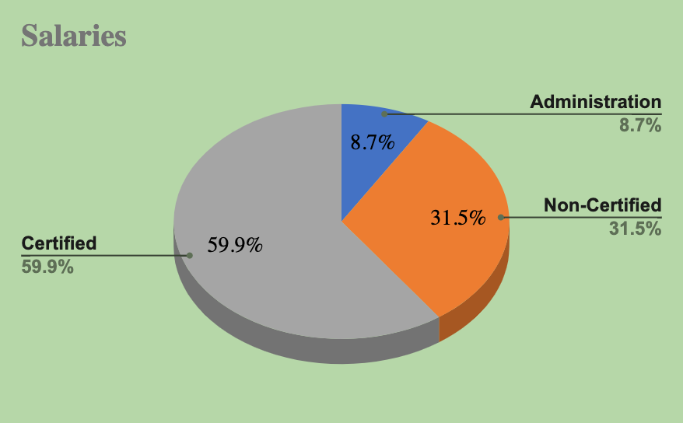
Proposed Budget Salaries:
Salary costs are 60.4% of operating budget.
Reduction of .5 Administrator
Addition of 1 full time Spanish Teacher
Addition of .5 School Psychologist or Library Media Specialist.
Substitutes are not broken out as certified/non-certified. Some substitutes are for certified teachers others for paras, kitchen and custodial.
2023-24 Proposed $5,247,954
2022-23 Budget $5,194,480
Increase $53,474
% increase 1%

Slide 20
Employee Benefits
 | 19-20 Actuals | 20-21 Actuals | 21-22 Actuals | 22-23 | 23-24
Employee Insurance | 1,204,073.23 | 1,201,245.22 | 1,338,958.53 | 1,704,683.77 | 1,863,225.00
Life Insurance | 12,754.97 | 14,399.80 | 13,427.03 | 17,856.00 | 16,165.00
SS/Medicare | 181,442.39 | 170,243.29 | 171,147.93 | 169,975.72 | 186,115.00
Retirement Benefits | 146,335.54 | 159,027.38 | 159,604.32 | 91,428.46 | 156,076.00
Tuition Reimbursement | 21,650.72 | 9,999.90 | 7,441.86 | 15,000.00 | 20,000.00
Unemployment Ins | 33,341.00 | 8,204.50 | 13,299.94 | 32,657.00 | 20,000.00
Worker's Compensation | 32,314.34 | 34,365.00 | 33,682.71 | 35,999.00 | 32,655.00
Other Benefits | 3,600.00 | 6,357.63 | 5,573.17 | 6,000.00 | 3,600.00
Professional Development | 12,523.22 | 1,103.09 | 10,084.80 | 12,450.00 | 12,450.00
Mileage | 687.81 | - | 1,075.42 | 1,170.00 | 1,000.00
Total Benefits | 1,648,723.22 | 1,604,945.81 | 1,754,295.71 | 2,087,219.95 | 2,311,286.00

Slide 21
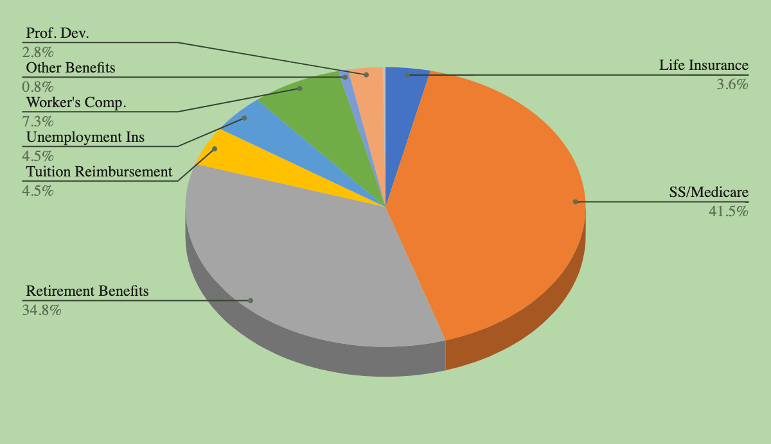
Proposed Budget Benefits
Medical Insurance to Increase by 20%
Dental to Increase by 10%
Life Insurance to Increase by 5%
1 Placeholder for Insurance
2023-24 Proposed $2,311,286
2022-23 Budget $2,087,220
Increase $224,066
% increase 10%

Slide 22
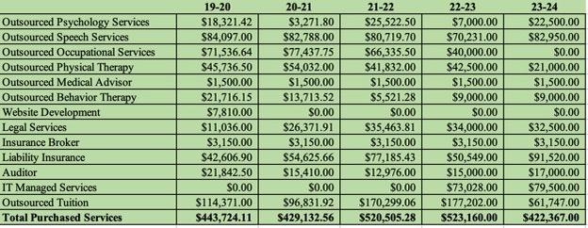
Services

Slide 23
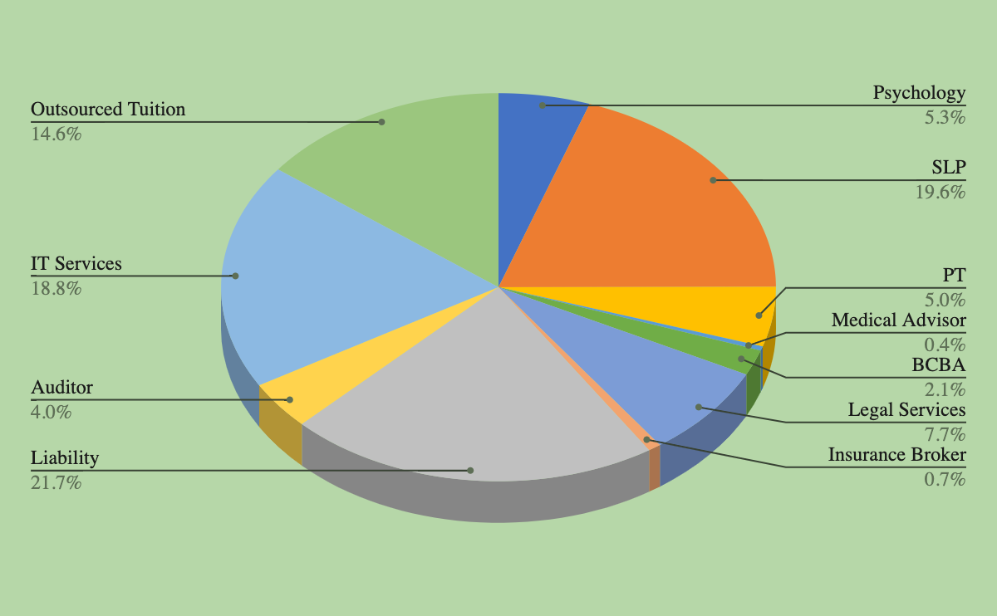
Proposed Budget Services
Only 1 outplaced special education student anticipated this year
OT outsourced providers brought on staff for 23-24 SLP Increase due to student need
In Liability the large increase is for projected Cybersecurity (based on claims in whole country, they should start coming back down)
2023-24 Proposed $422,367
2022-23 Budget $523,160
Decrease $100,793
% decrease 24%

Slide 24
Supplies
 | 19-20 Actuals | 20-21 Actuals | 21-22 Actuals | 22-23 | 23-24
Supplies, Other | 111,580.99 | 129,253.54 | 137,905.69 | 51,312.00 | 109,690.00
Instructional Supplies | 94,184.51 | 95,649.89 | 107,876.58 | 50,232.00 | 79,654.00
Books & Periodicals | 3,874.61 | 1,155.78 | 4,005.29 | 2,900.00 | 16,100.00
Diesel & Gasoline | 41,916.78 | 22,745.53 | 25,437.26 | 65,656.00 | 72,685.00
Heating Oil | 65,638.11 | 65,795.06 | 50,847.24 | 92,140.00 | 122,190.00
Building Utilities | 54,907.56 | 57,808.43 | 59,585.45 | 74,167.00 | 65,000.00
Total Supplies | 372,102.56 | 372,408.23 | 385,657.51 | 336,407.00 | 465,319.00

Slide 25
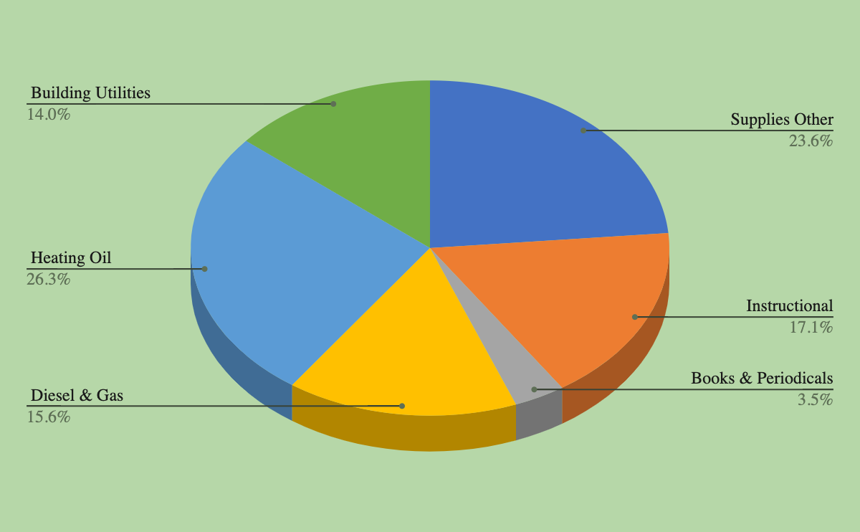
Proposed Budget Supplies
Reduction of $12,500 due to new phone system
Heating Oil is based on 34,000 gallons @ $3.5889 plus tax
Diesel is based on 36,000 gallons @ $3.6616 plus tax minus contributions from DPW, Fire/Ambulance Service, and Region 19 Transportation contract
Textbooks for World language courses Increase in Science for programming along with overall increase supplies for teaching and learning
2023-24 Proposed $465,319
2022-23 Budget $336,407
Increase $128,912
% increase 27%

Slide 26
Budget Development

Slide 27
Budget Development Process
Examined past years actual expenditures. Focusing on the budget year 2019/2020. These are actual numbers pre-COVID.
Surveyed the teachers for the needs of classroom for instruction.
Surveyed teachers on technology needs for instructional purposes.
Met as administrative team to look line by line for needs to increase student instructional demands.
Examine class size and staffing review according to needs.
Met with Board of Education starting in November to discuss process and timeline.
Set up community opportunities through Coffee and Conversation on November 2, 2022 and a Saturday work session on Nov.12, 2022. Advertising opportunities through the Ashford Citizen and K12 alerts.

Slide 28
Accounting Codes Structure
Sample | 100.1000.100.30.1.10
Fund | Function | Object | Extension | Education Type | Department ID
Indicates Funding Source | Indicates School Program | Indicates the Type of Expense | Breaks Down the Function | Regular or Special Ed | Used to further clarify expense if necessary

Slide 29
Accounting Code Structures continued…
Fund
100 Series | General Budget Fund
200 Series | Federal/State Grants
300 Series | Miscellaneous Grants
Function
1000 | Regular Education Instruction
1200 | Special Education Instruction
2100 | Support Staff
2130 | Health Services
2140 | Outsourced Psychologist
2150 | Speech
Education Type
1 | Regular Education
2 | Special Education
3 | Transportation
Department ID (Examples)
10 | Central Office
11 | Ashford School
12 | Special Education
13 | Maintenance
Object
100 | Administrators
110 | Non-Certified Staff
111 | Certified Staff
210 | Employee Benefits
Extension (Examples)
10 | Elementary School
20 | ESY Program
50 | Middle School

Slide 30
Grant |  | Anticipated Amount |  | Important Note: Monies are already subtracted from the budget
Title I (continuous) |  | 56,000.00 |  | Partially funds a Math Interventionist plus a set-aside portion for homeless student transportation
Title II(continuous) |  | 9,400.00 |  | Used for Professional Development (PD) of Staff
Title III(continuous) |  | 800.00 |  | Used for EL supplies and programs
Title IV(continuous) |  | 10,000.00 |  | Used for technology purchases not included in regular budget
REAP(continuous) |  | 30,000.00 |  | Educational supplies, books, technology, PD
IDEA 611(continuous) |  | 117,275.00 |  | Funds salaries for 1.5 Special Education teachers
IDEA 619(continuous) |  | 7,168.00 |  | Partially funds one paraprofessional
School Readiness (Continuous) |  | 113,400.00 |  | Partially funds our Pre-K program
School Readiness Quality Enhancement (Continuous) |  | 3,881.00 |  | Funds programs for Preschoolers
ESSER III (Expended by September 2024) |  | 330,000.00 |  | Funds curriculum writing and supplies, and technology in our classrooms to address learning loss from the pandemic,BCBA services and additional speech related services.
Notes:
Total of grants is $677,924. Funds have been subtracted from the budget that we are

Slide 31
Next Steps:
BOE Budget Workshop February 16, 2023: BOE review and discuss budget. Finalize information going to the Board of Finance on March 2, 2023.
BOE attend BOF March 2, 2023: BOE presents to the BOF their 2023/2024 budget requests and answer questions.
BOF March 16, 2023: Reviews Budget requests with additional clarifications and discuss recommendations.
BOF March 23,2023: BOF adopts proposed budget and sets the date for Public Hearing.
Proposed Town Public Hearing April 4, 2023: Public Hearing, last chance to make any changes to budgets.
April 5, 2023: BOS Sets dates and approves notice for Town Meeting and Referendum.
April 14, 2023: Town budget books available to the public.
April 18, 2023: Annual Town Meeting.
May 2, 2023: Proposed Ashford Town Budget Referendum.

Slide 32
Thank you for all your support and hard work over the years. We have a special community surrounding our Ashford children.

